Slide 1
FRAMEWORK FOR TECHNOLOGY DECISIONMAKING
Apr. 15, 2020

Slide 2
FIND US AT https://ctaa.org/about-n-catt/
Notes:
CTAA – membership organization of transit systems, transportation providers, state DOTs, human services agencies, planning agencies and others committed to transportation access for people of all ages and abilities throughout the United States.

Slide 3
National Technical Assistance Center
Launched in late 2019
Operated by Community Transportation Association of America
Through a cooperative agreement with the Federal Transit Administration (FTA)

Slide 4
The National Center for Applied Transit is the newest technical assistance center funded by the Federal Transit Administration (FTA). N-CATT’s mission is to provide small-urban, rural, and tribal transit agencies with practical, replicable resources that help them apply technological solutions and innovations. N-CATT is carrying out this mission by analyzing information, communicating it, helping transit systems plan, and encouraging implementation of cost-effective, value-adding technology.

Slide 5
So, you want some technology
What are your needs?
How did you get to that?
How will you prioritize with the resources you have?
What will get you closest to accomplishing your goals?
Who can you collaborate with?
Group resources, band together!
Learn from peers – pitfalls, strategies, etc.

Slide 6
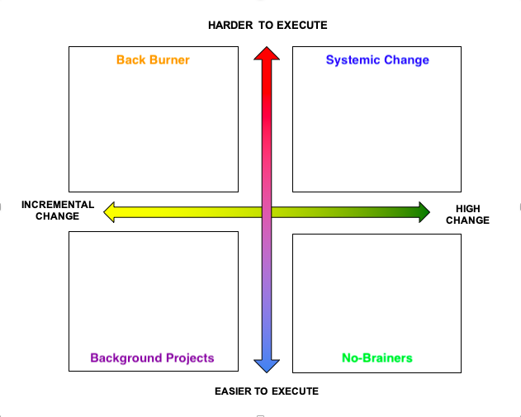

Slide 7
It’s worth it! Probably
Be deliberate, be focused
Learn vendor-speak
Test, test, test
Determine the return on investment

Slide 8
Framework for Making Technology Decisions
April 15, 2020 National Center for Applied Transit Technology
Kevin Chambers Full Path Transit Technology

Slide 9
Framework for Making Technology Decisions
Define Problem
Develop Solution
Procure
Implement
Celebrate!

Slide 10
Thank you.
Just kidding!
Questions?
There are barriers to using this model.

Slide 11
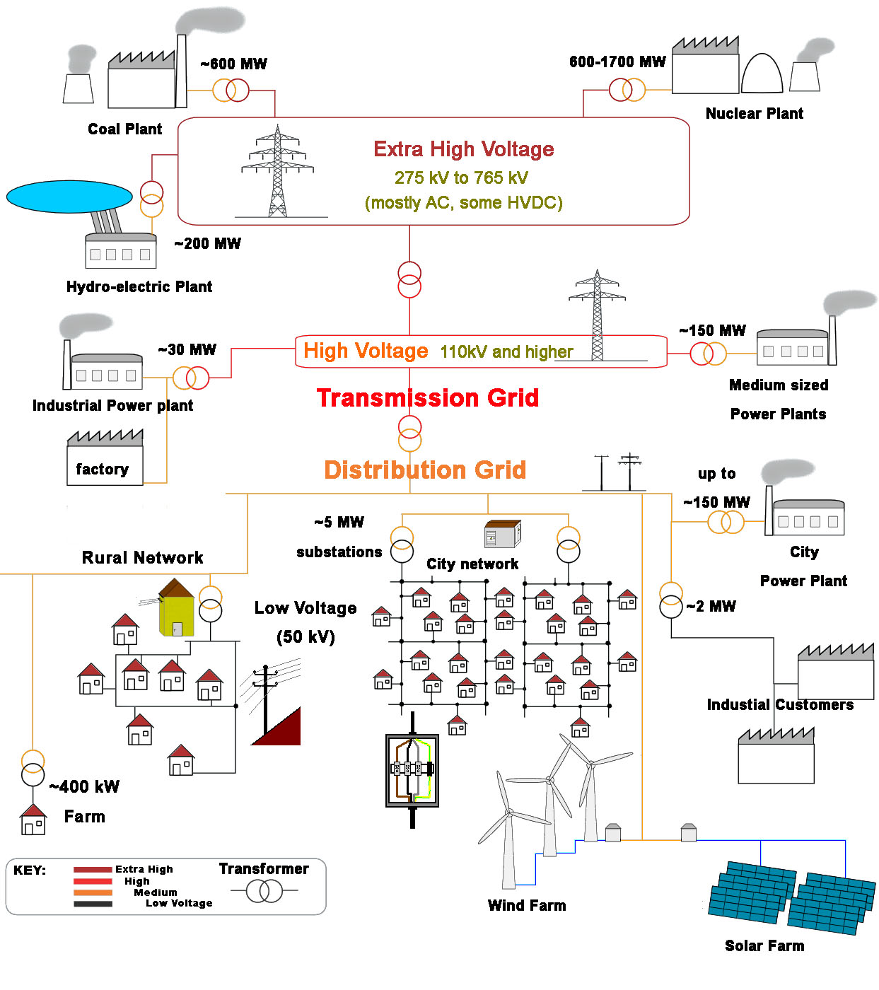
What We Wish For
What We Have

Slide 12
Key Barriers to Applying Technology in Transit
Misidentifying the Problem
Underestimating Costs, Overestimating Benefits
Lack of Systems Thinking & Risk Management Tools
Abundance of Complexity
Consumer-Centered Thinking
Absence of Standards

Slide 13
Define Problem
Develop Solution
Procure
Implement
Celebrate!

Slide 14
Defining the Problem is Key
“We fail more often because we solve the wrong problem than because we get the wrong solution to the right problem.” — Russell L. Ackoff
Don’t include a preconceived solution as part of your problem
Technology is never an end unto itself.
Dig down to the underlying need.
What are the simplest solutions that solve the problem?
Use risk management as a lens for defining problems.

Slide 15
Define Problem
Develop Solution
Procure
Implement
Celebrate!

Slide 16
“Technology” Itself Is Not a Solution
“Technology is everything that doesn't work yet.” — W. Danny Hillis
The key “technology” in transit is the vehicle
Service and service design should lead
This is an area to iterate and learn
Be very cautious using technology to solve institutional problems
Lean towards simple solutions

Slide 17
March 29, 2020
“The alarm system was ready. Scarred by the SARS epidemic that erupted in 2002, China had created an infectious disease reporting system that officials said was world-class: fast, thorough and, just as important, immune from meddling.
Hospitals could input patients’ details into a computer and instantly notify government health authorities in Beijing, where officers are trained to spot and smother contagious outbreaks before they spread.
It didn’t work.
After doctors in Wuhan began treating clusters of patients stricken with a mysterious pneumonia in December, the reporting was supposed to have been automatic. Instead, hospitals deferred to local health officials who, over a political aversion to sharing bad news, withheld information about cases from the national reporting system — keeping Beijing in the dark and delaying the response.”
(Emphasis added)

Slide 18
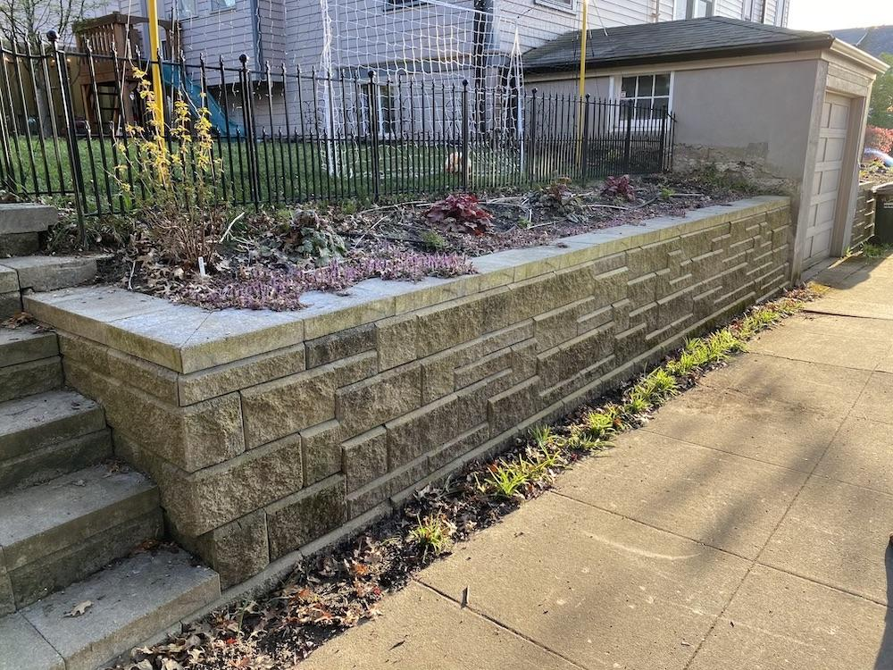
Keep Retaining Walls 4 ft or Lower If Possible
This should have been engineered
This didn’t require engineering
Systems engineering is key to success for complex projects
There is no clear “four feet” guideline in our industry.
Don’t want to do S.E.? Consider simplifying requirements.
“But the vendor already figured it out.” Well, maybe.

Slide 19
Define Problem
Develop Solution
Procure
Implement
Celebrate!

Slide 20
Start from your Minimum Viable Product
“If everyone is special, no one is.” — Dashiell Parr
Know what’s important and rank ruthlessly
The smaller the problem space, the simpler the solution can be
Technology is limited primarily by our ability to manage its complexity
One approach: work backward from the resources you’ll have to maintain what you procure

Slide 21
Risk Management Supports Prioritization
 | Low Likelihood | Medium Likelihood | High Likelihood
High Impact | Natural disaster with sustained loss of power Global pandemic | Office internet access outage | Staff turnover Major software upgrade
Medium Impact | Bus barn loss of HVAC | Workstation failure Tablet failure Driver data entry error | Minor software upgrade
Low Impact | Bus barn door motors fail | Misspelled pickup address | Cell network dead zone

Slide 22
Key Risk Management Strategies
Dig down to core problems
Carefully analyze costs and benefits
Apply systems thinking
Engineer only when needed
Cultivate leadership- and trade-off-based thinking
Use standards and support development of more

Slide 23
Define Problem
Develop Solution
Procure
Implement
Celebrate!

Slide 24
Thank you!
(For real this time)
Kevin Chambers
kc@fullpath.io

Slide 25
Contacts
grossglaser@ctaa.org, 202-386-1669
carpenter@ctaa.org, 202-415-9688
kc@fullpath.io

